Slide 1
LIBRARY MANAGEMENT SYSTEM
SUJAL LUHAR
PRIYANSH DAHAKE

Slide 2
Specifications:
Library management systems are designed to manage the movement of books and maintain records of the members in a library.
It is also responsible for keeping record of the person who had damage the books or if they have submitted the book back that they had.
It also make sure if the price of damaged books is given by that particular person.

Slide 3
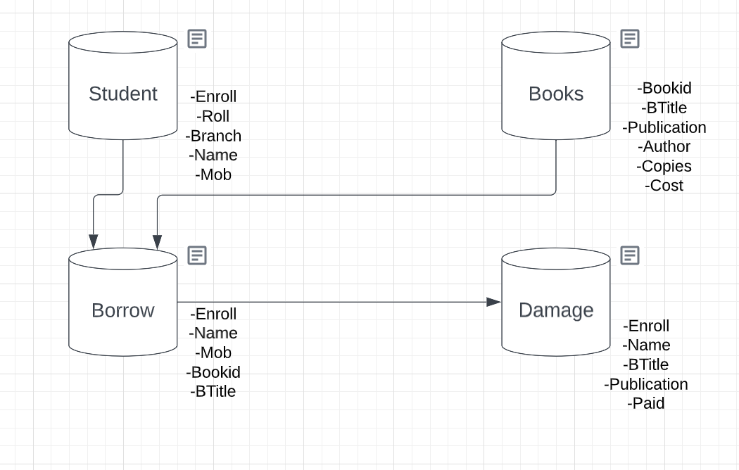
OVERVIEW

Slide 4
What else could we do:
We can add details of publication, so that if they come up to new latest books we can contact them to place order.

Slide 5
THANK YOU

